Slide 1
Getting Started with ZW3D API
John Zhang

Slide 2
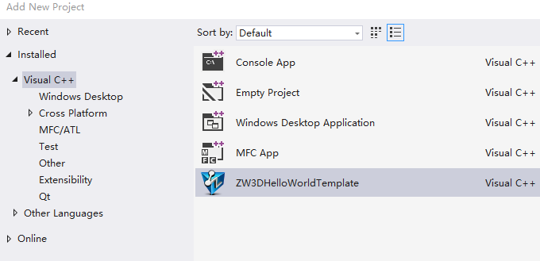
1.How to created the project In VS2017
Install ZW3D
https://www.zwsoft.com/product/zw3d
Install ZW3DWizard
New Wizard for quickly create project in Visualu Studio 2017.
https://github.com/ArphonePei/ZW3DAPISamples/blob/master/ZW3DWizard.vsix
Create the test project based on the ZW3DHelloWorld Template

Slide 3
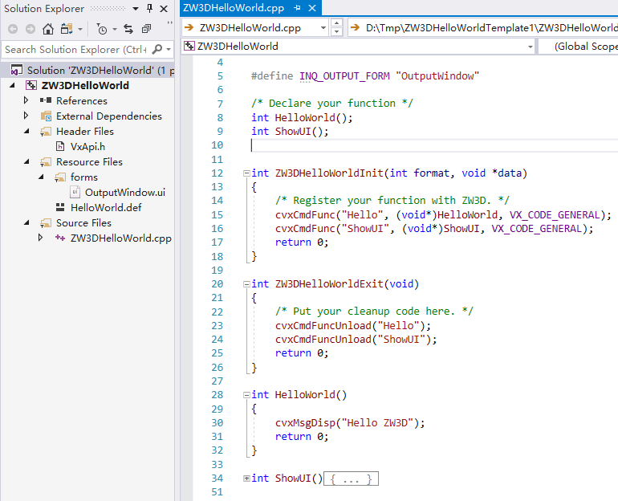
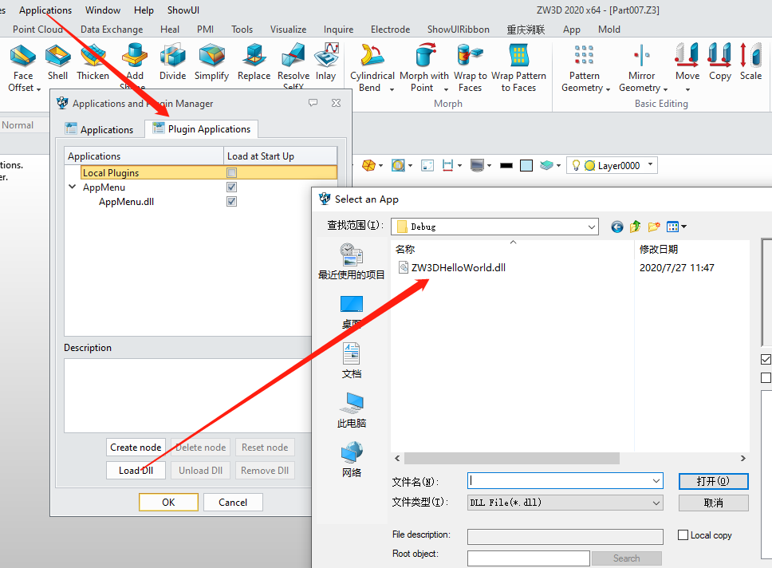
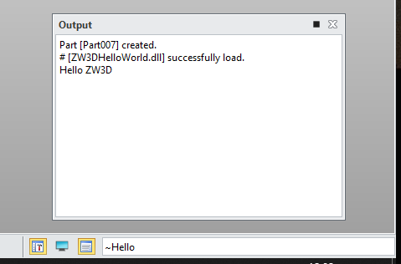
2. Call the customize command in ZW3D
Build the project
Open ZW3D and load the dll
Run the function ~Hello in the output window/command window

Slide 4
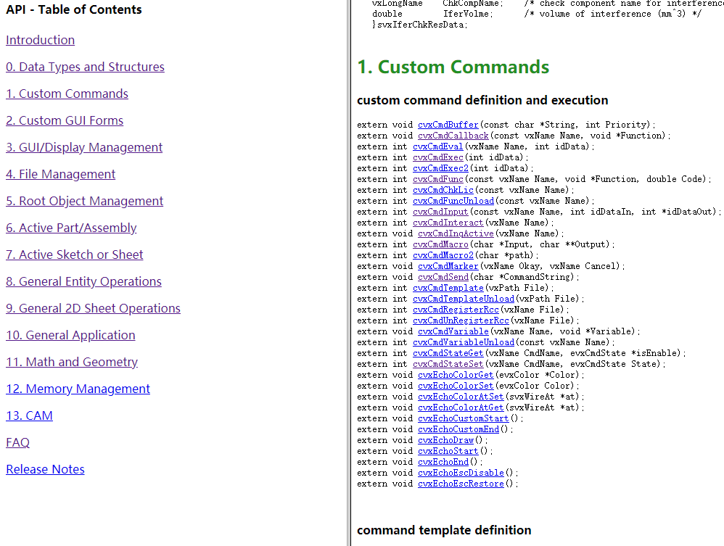
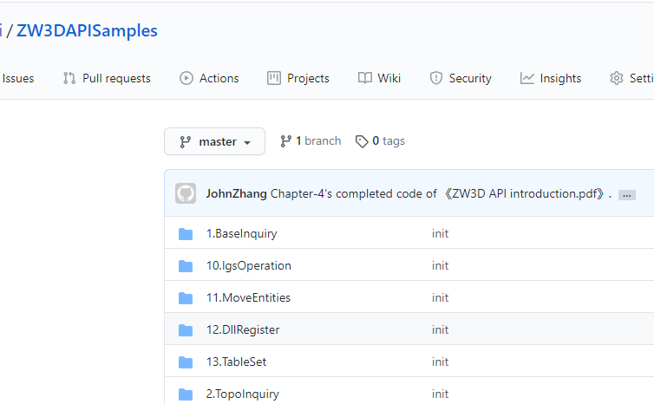
3.Resources of ZW3D API
《ZW3D API introduction.pdf》
C:\Program Files\ZWSOFT\ZW3D 2020\api
Help document
C:\Program Files\ZWSOFT\ZW3D 2020\api\ApiDoc.zip.
API Samples
https://github.com/ArphonePei/ZW3DAPISamples
MyBox-Chapter-3’s completed code of ZW3D API introduction.pdf
SetColor-Chapter-4’s completed code of ZW3D API introduction.pdf
Email:
zdn@zwsoft.com/zdn@zwcad.com

Slide 5
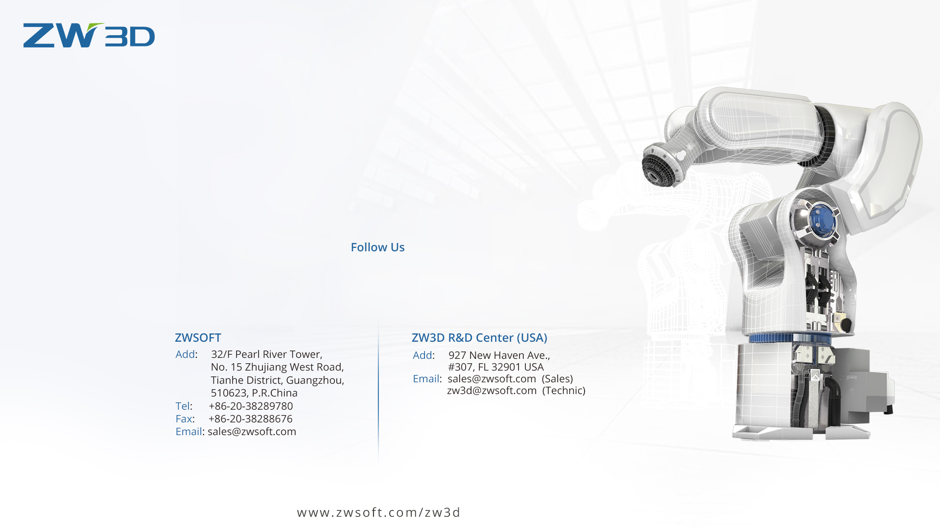




Thanks

